Slide 1
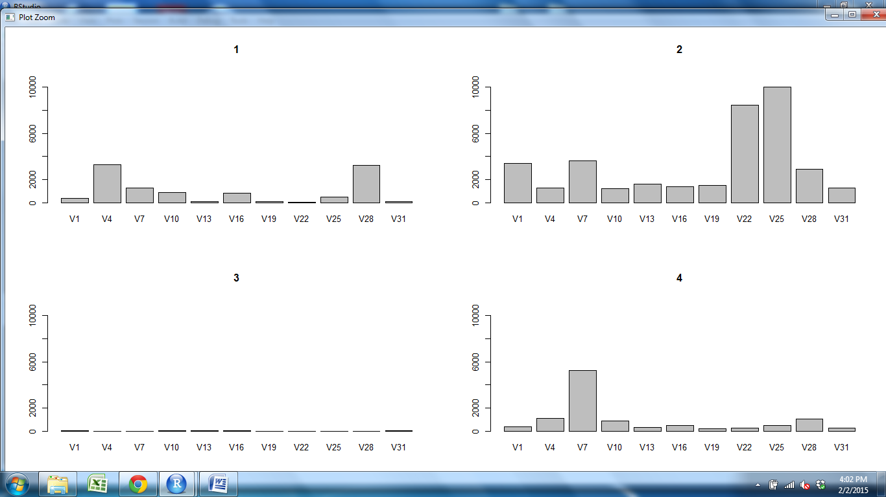
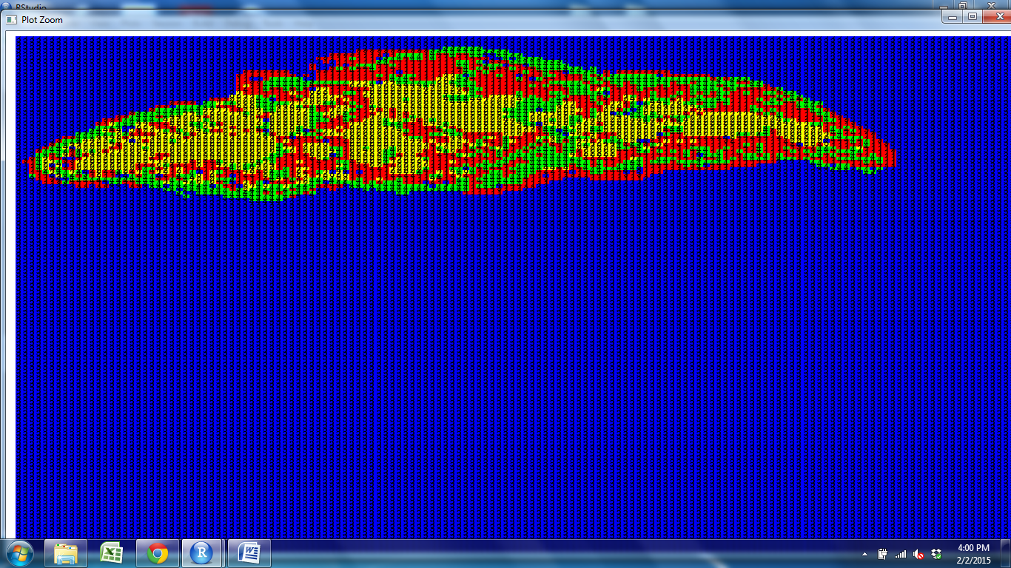
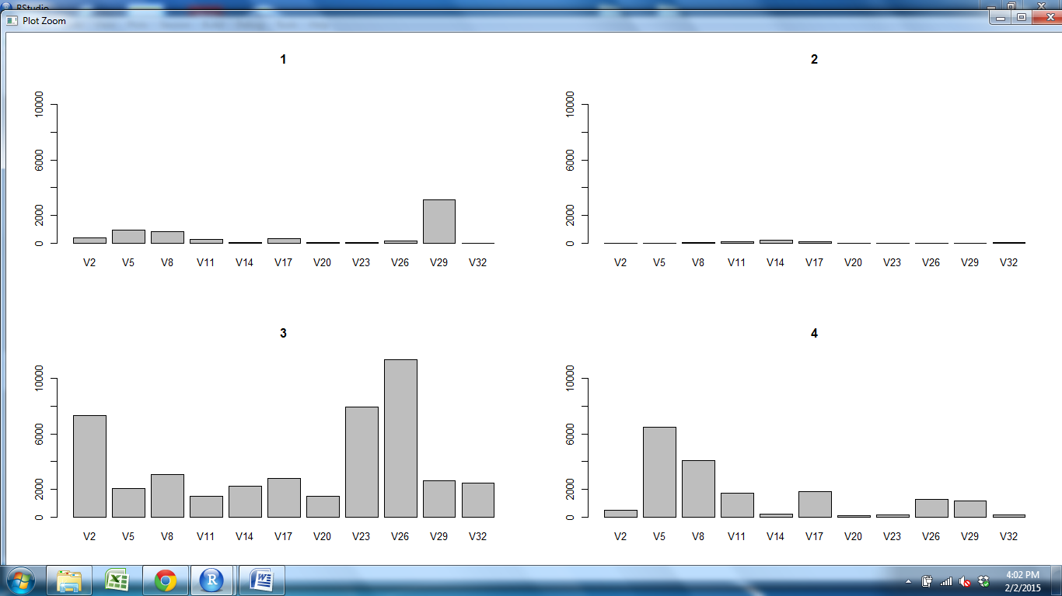
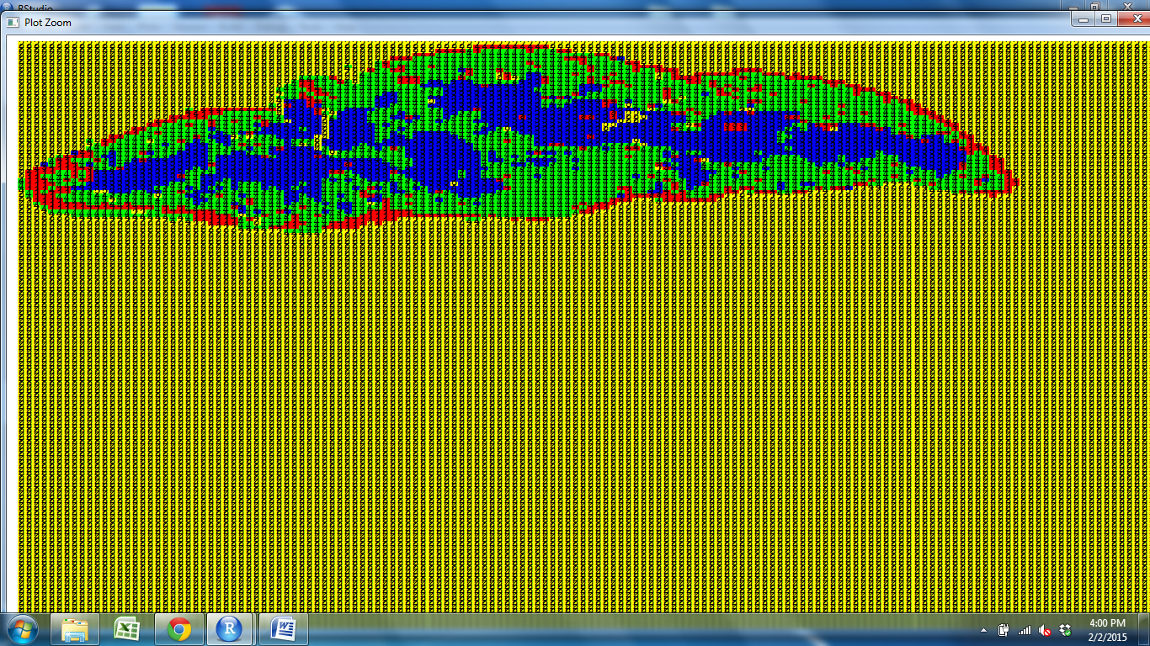
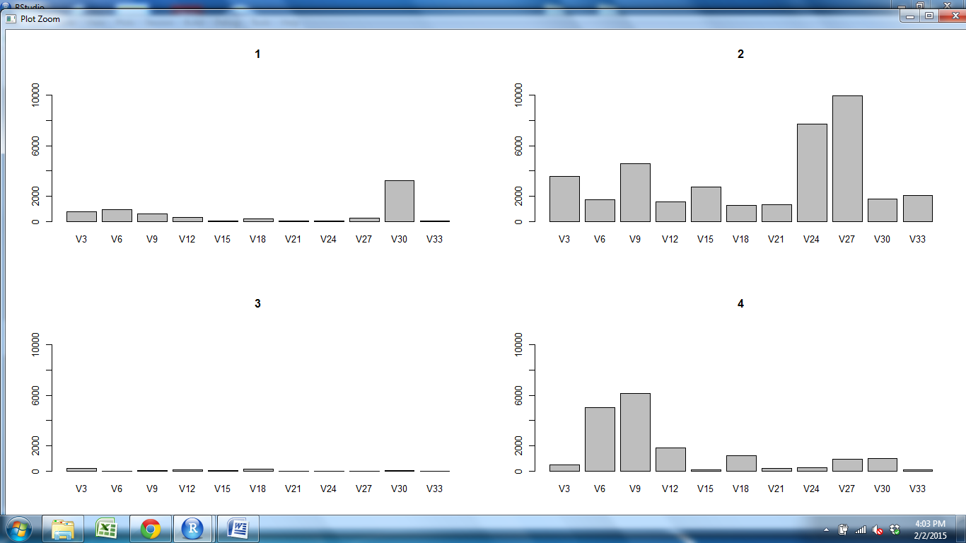
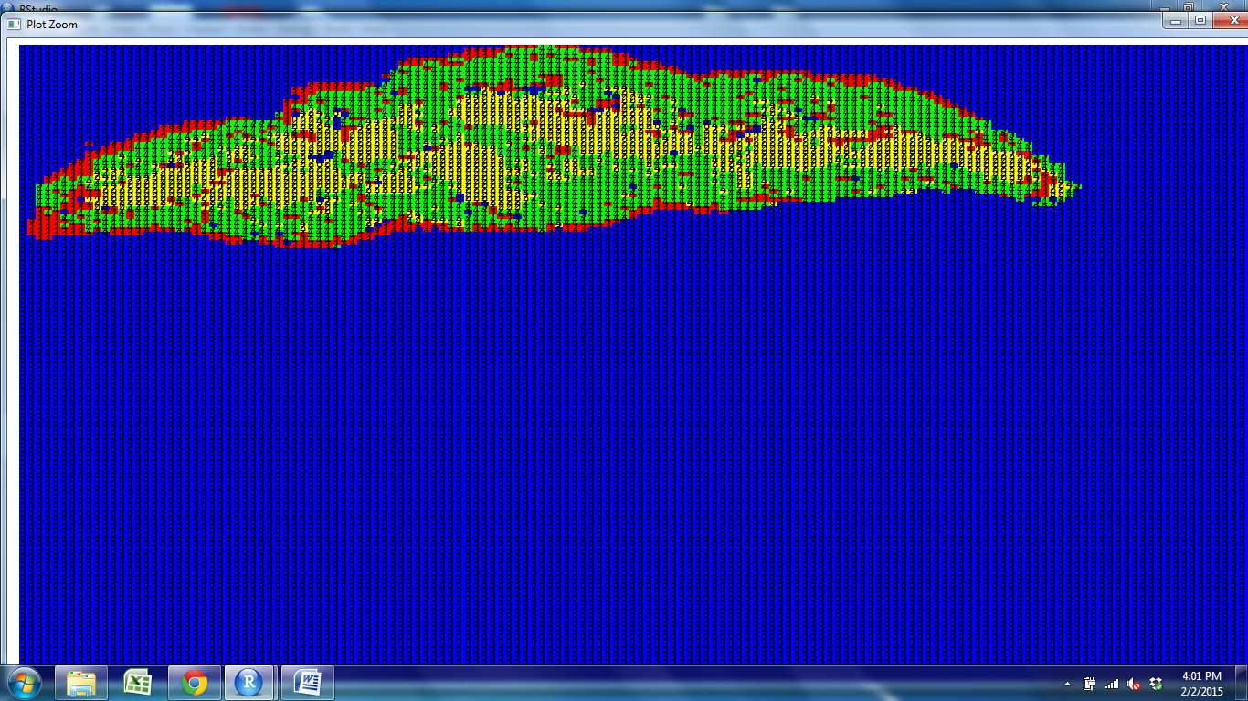
CD11c CD205 CD25 CD31 Claud34 Claud5 Foxp3 K14 K5 PDGFRb UEA1

Slide 2
CD11c CD205 CD25 CD31 Claud34 Claud5 Foxp3 K14 K5 PDGFRb UEA1

Slide 3
CD11c CD205 CD25 CD31 Claud34 Claud5 Foxp3 K14 K5 PDGFRb UEA1

Slide 4
CD11c CD205 CD25 CD31 Claud34 Claud5 Foxp3 K14 K5 PDGFRb UEA1

Slide 5
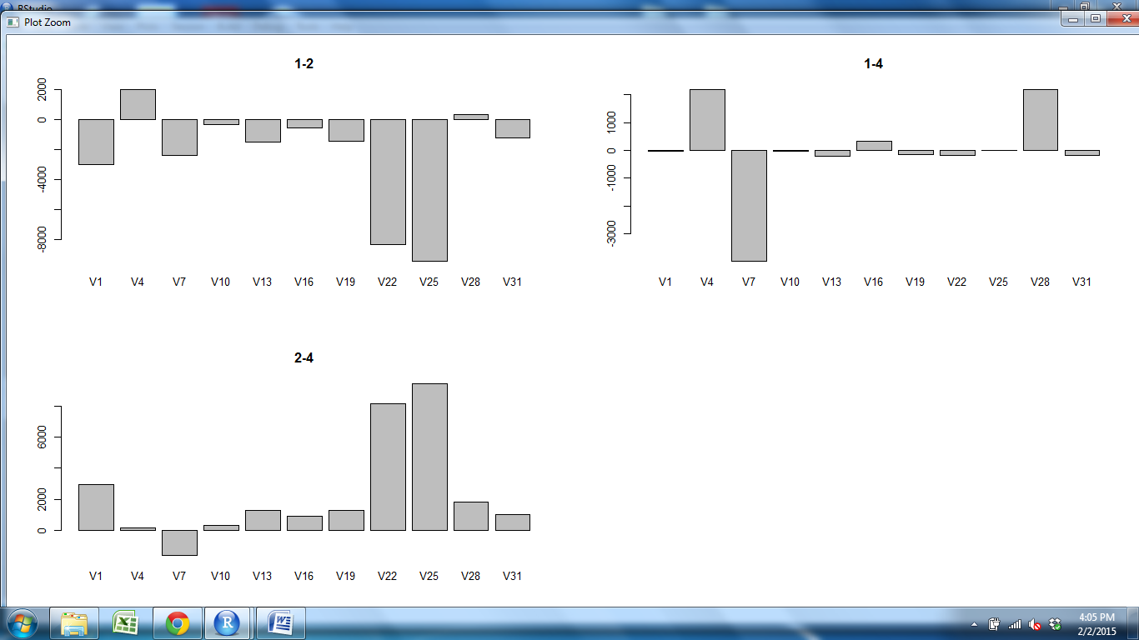
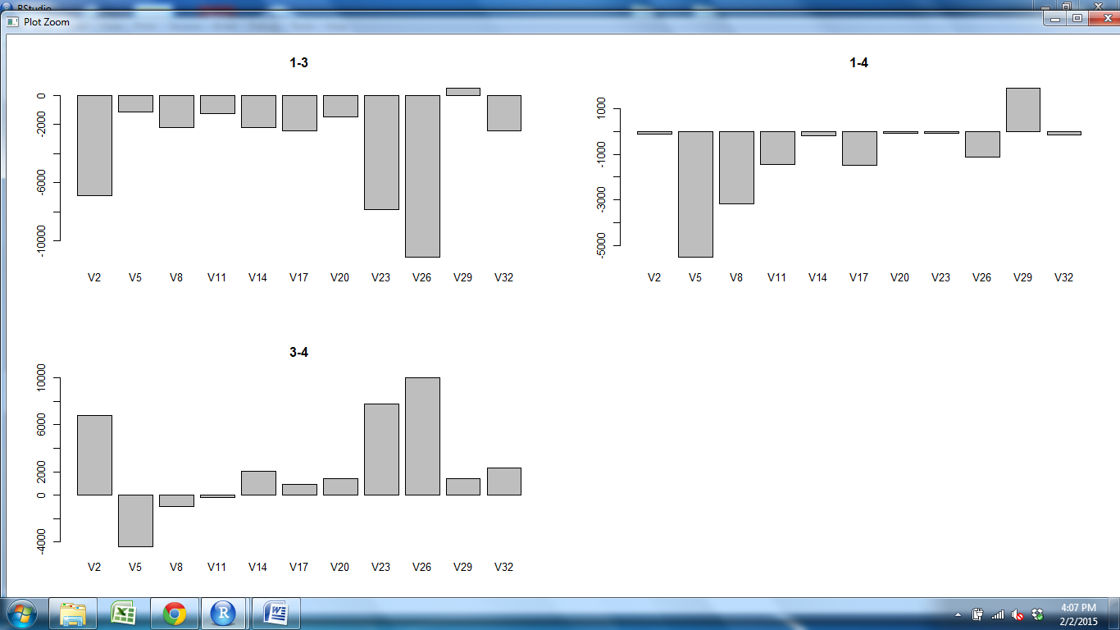
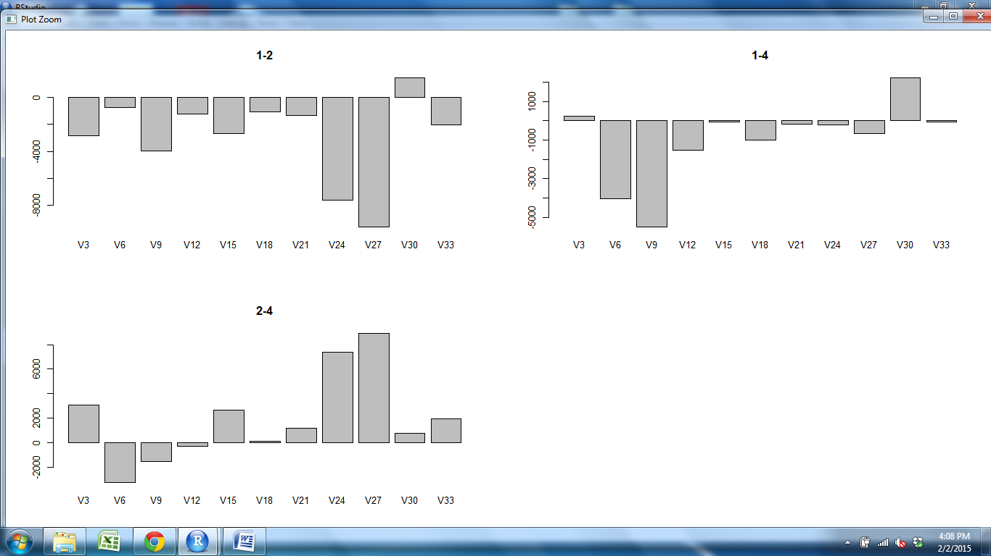
CD11c CD205 CD25 CD31 Claud34 Claud5 Foxp3 K14 K5 PDGFRb UEA1

Slide 6
CD11c CD205 CD25 CD31 Claud34 Claud5 Foxp3 K14 K5 PDGFRb UEA1

Slide 7
CD11c CD205 CD25 CD31 Claud34 Claud5 Foxp3 K14 K5 PDGFRb UEA1

Slide 8
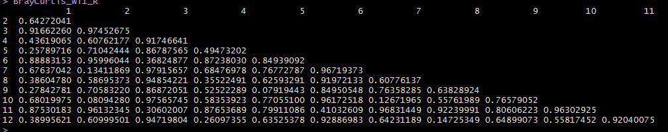
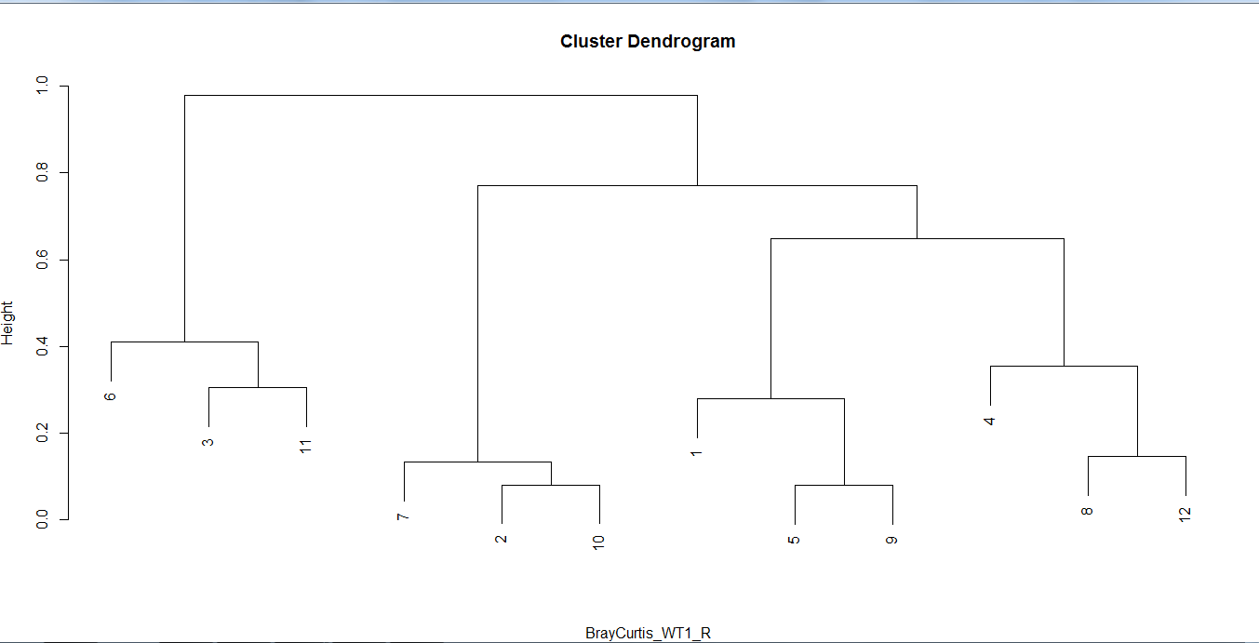
Subcap M Outer Cortex Subcap Outer M Cortex Subcap M Outer
M
Outer
Cortex
Subcap
Outer
M
Cortex
Subcap
M
Outer
Cortex
S2Outer S1Outer S3Outer S2M S1M S3M S1Subcap S2Subcap S3Subcap S1Cortex S2Cortex S3Cortex

